Slide 1
Nevada OHV Program Grantee Feedback Survey Results
August 12, 2025

Slide 2
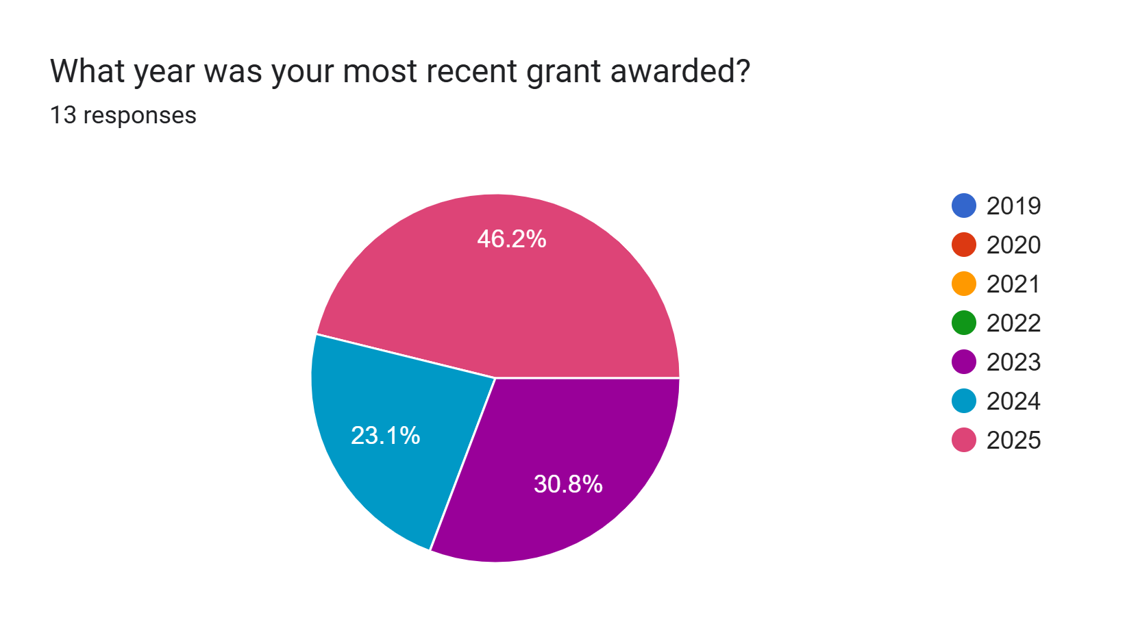

Slide 3
Application Process

Slide 4
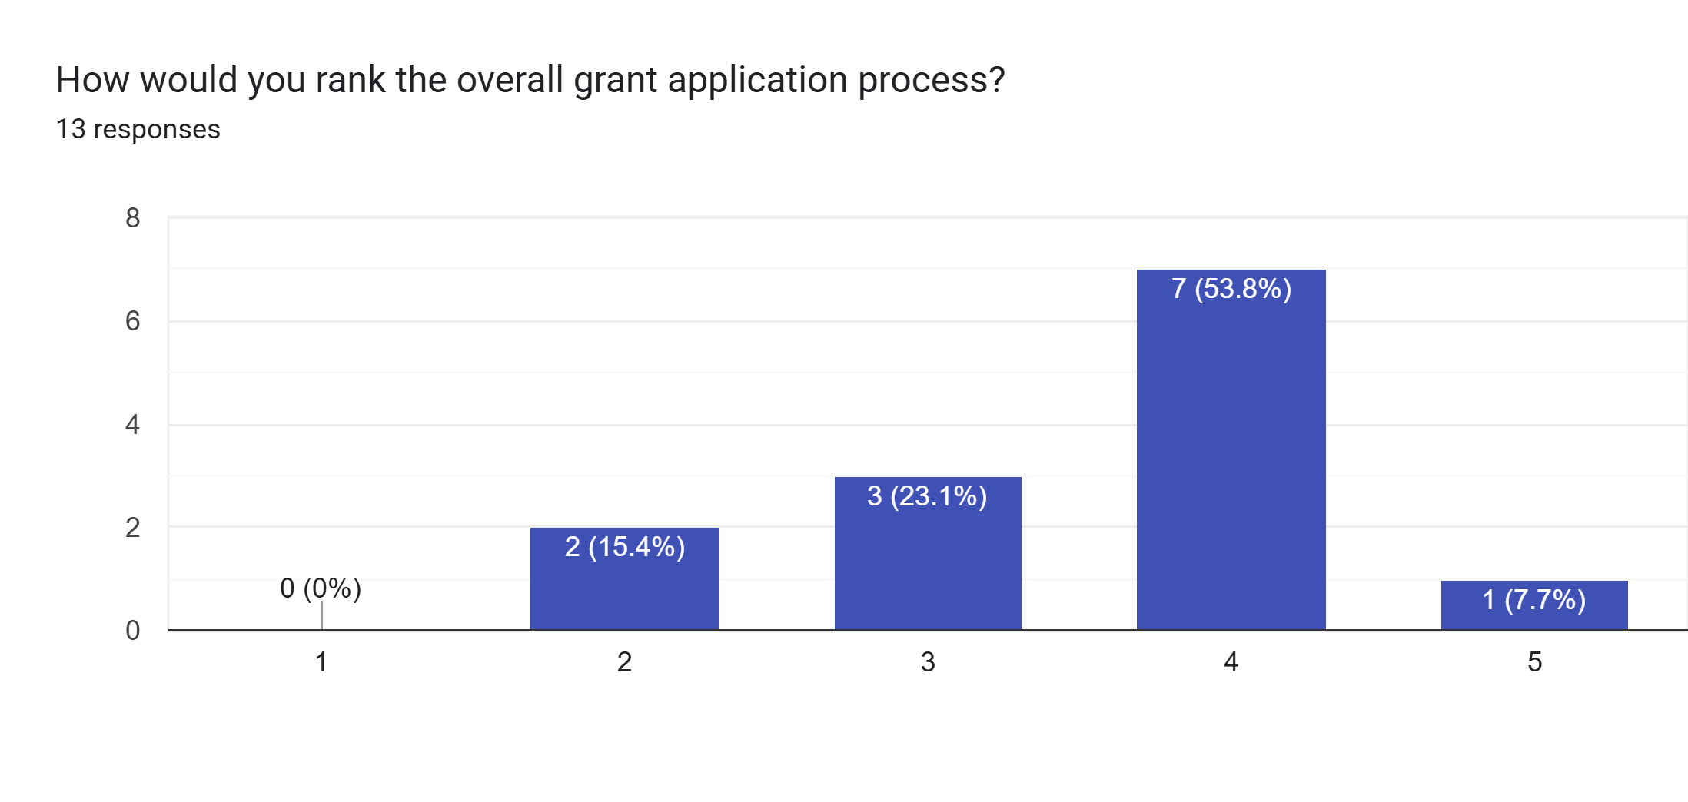
Number of Responses
Difficult and Tedious
Straightforward and Easy

Slide 5
Application Process Feedback
(10 Responses)
Positive
Negative
Application process is straight forward
Application videos made were helpful for first-time applicants
Pre-grant training was easy to follow and helpful
Applicants felt Commissioners were not prepared with application review and questions
Mandatory training requirements are cumbersome
First time applicants find the process intimidating and needed assistance
Unclear definitions of what an “incomplete” application is
  “I will say hearing that the applications were "incomplete" if we put N/A was a struggle”

Slide 6
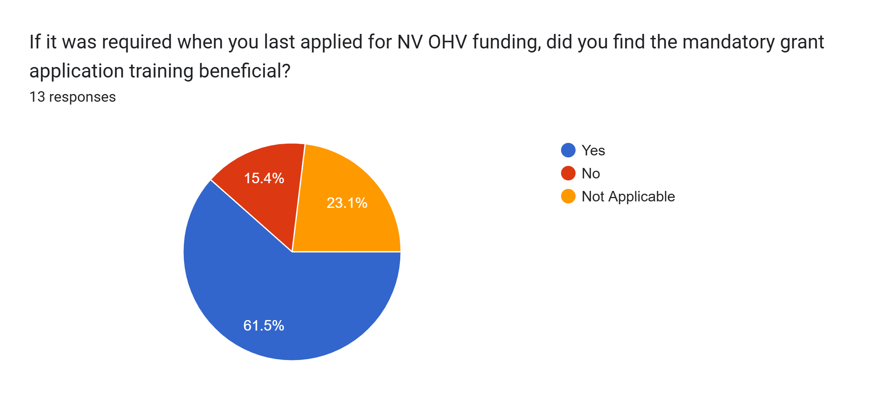

Slide 7
Mandatory Training Feedback
(7 Responses)
Positive
Negative
Majority of responses found trainings helpful
Comprehensive
Helpful for first time applicants
“I thought it covered everything”
Another meeting to account for
Wasn’t helpful to just read over the application together
Did not feel necessary for repeat applicants
Needs more specific advice regarding:
  Photos including OHVs, not full-size vehicles
  Definition of what an “incomplete” application is
  Post-award processes such as RFR process and reporting

Slide 8
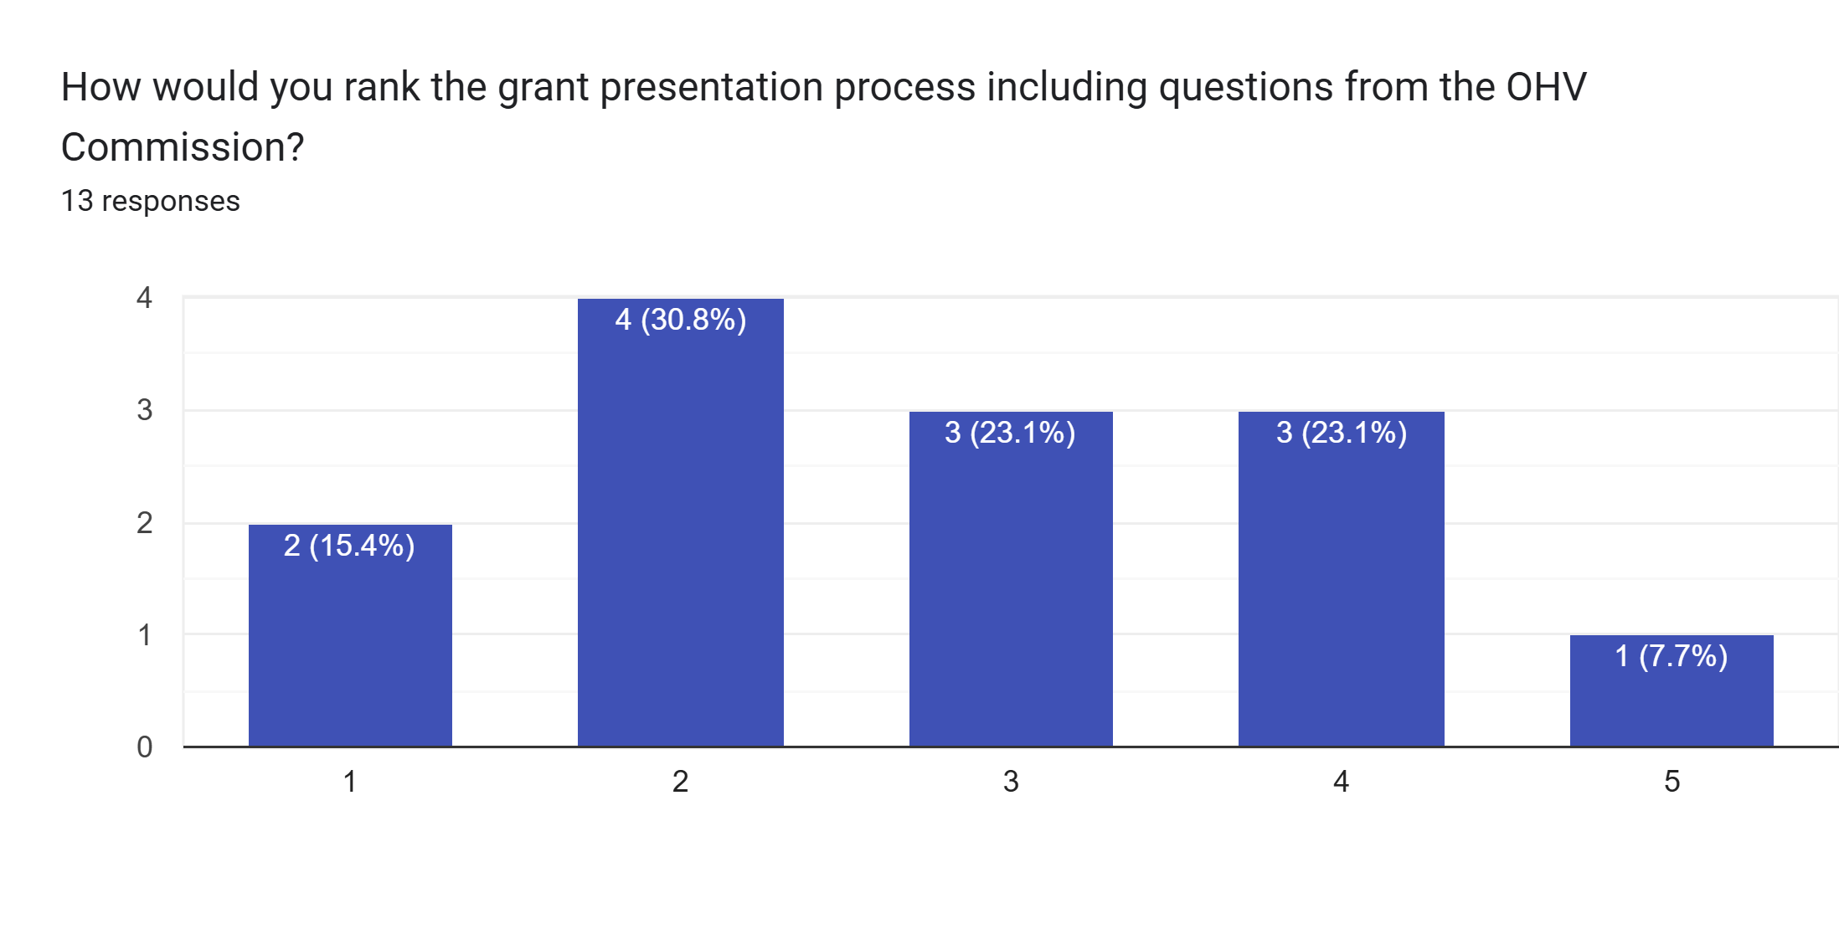
Number of Responses
Difficult and unclear
Straightforward and Easy

Slide 9
Presentation Process and Questions from the OHV Commission Feedback
(12 Responses)
Positive
Negative
Easy for anyone to present if they prepare
Unclear definition of an “incomplete” application is
Commission’s questions were antagonistic, overly negative, and critical
Disrespectful treatment of applicants
Unclear on process and attendance standards (can grantees leave meeting after presentations)
Commissioners unprepared for grant review
Not being able to control ones own Power Point

Slide 10
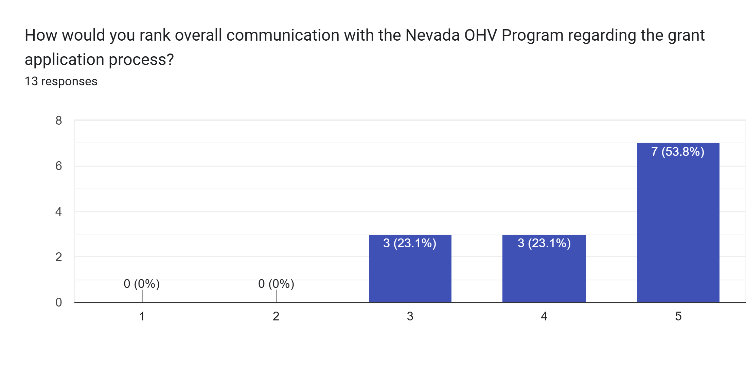
Number of Responses
Nevada OHV was unresponsive and unhelpful
Nevada OHV was responsive and helpful

Slide 11
OHV Program Communication during Application Process (10 Responses)
Positive
Negative
Helpful and responsive in a timely manner
Professional
“I have never had a bad experience with the OHV Program”
Communication has improved since change in Program management
No complaints
Could provide more communication throughout the grant process

Slide 12
Additional Feedback for the Application Process (6 Responses)
“Application process is fine, not much could be changed. But the meeting was absolutely horrible”
Having additional trainings or the opportunity to be mentored
Don’t belittle or shame applicants
More training on post-award processes (RFR, reporting)

Slide 13
Post-Award

Slide 14
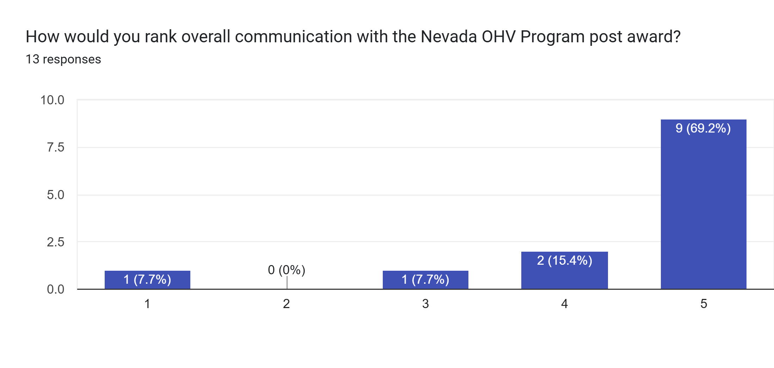

Nevada OHV was unresponsive and unhelpful
Nevada OHV was responsive and helpful

Slide 15
Post-Award Program Communication (10 Responses)
Positive
Negative
Reponses and information is timely and helpful
Post management change quarterly reporting reminders have been appreciated
“The staff changes left a few gaps, but I think Kaden in doing well.”

Slide 16
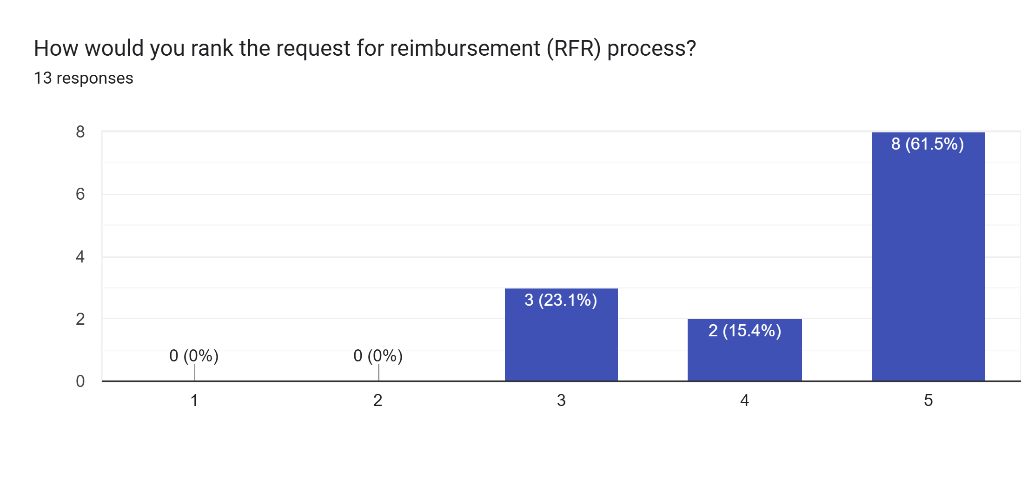
Number of Responses
Difficult and unclear
Straightforward and easy

Slide 17
RFR Feedback (10 Responses)
Positive
Negative
Similar to other grant programs
Self explanatory
Clear and easy to understand
Easier than other grants
First time through the process can be difficult
Intimidating for grantees new to grants
Travel reimbursement changes are confusing

Slide 18

Number of Responses
The OHV Program has not been helpful
The OHV Program has been helpful

Slide 19
OHV Program RFR Assistance Feedback (8 Responses)
Positive
Negative
Prompt responses
Easy to work with
Good communication
“Since our first payment request, the OHV team has noticeably improved its ability to help us provide what the OHV team needs to quickly process our requests.”
Slow payment process
More flexibility

Slide 20
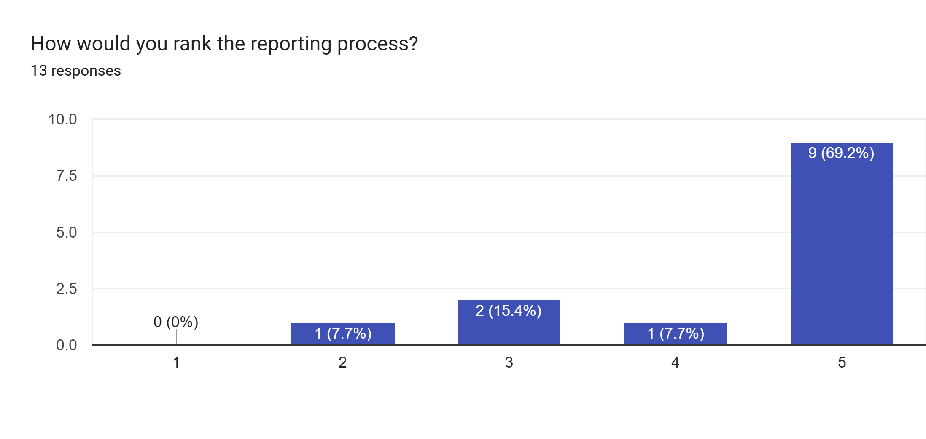
Number of Responses
Difficult and unclear
Straightforward and easy

Slide 21
Reporting Process Feedback (8 Responses)
Positive
Negative
Simple after the first report
Easy process
Convenient
“Prior to OHV program management change, we would not receive courtesy reminders about quarterly reports being due. Now approximately 1-2 weeks before each quarterly due date, we receive a reminder from the OHV program, which is very helpful for our organization which is constantly balancing multiple grants”
No comments

Slide 22
Additional Post-Award Feedback
“When a medical emergency interfered with our timeline, the grant administrators were willing to work with us - which we are grateful for”
“Overall, easy and I like it is submitted via email”

Slide 23
Future OHV Grant Rounds

Slide 24
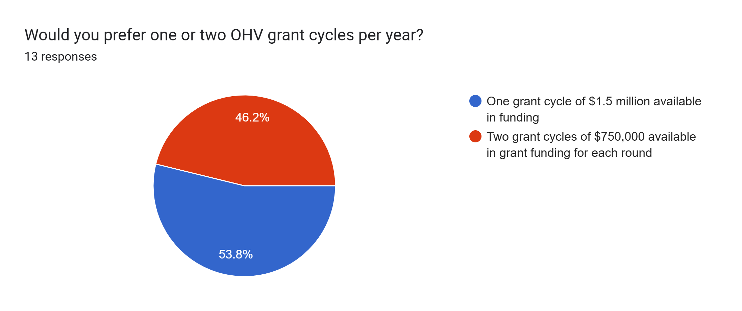

Slide 25
Preferred Amount of Grant Cycles (9 responses)
One (53.8%)
Two (46.2%)
Process is tedious and time consuming, would rather do it once a year
“I've managed grant programs for over 15 years and running two cycles/year is way too time-consuming and is not an efficient use of staff time”
Simple for reporting
Two cycles limits size of project
More work for grantees, applicants, staff and commissioners
Good for organizations that utilize different fiscal years
“Should a need arise after the initial grant cycle, having two allows you to apply again and potentially gain assistance without having to wait for the next year”

Slide 26
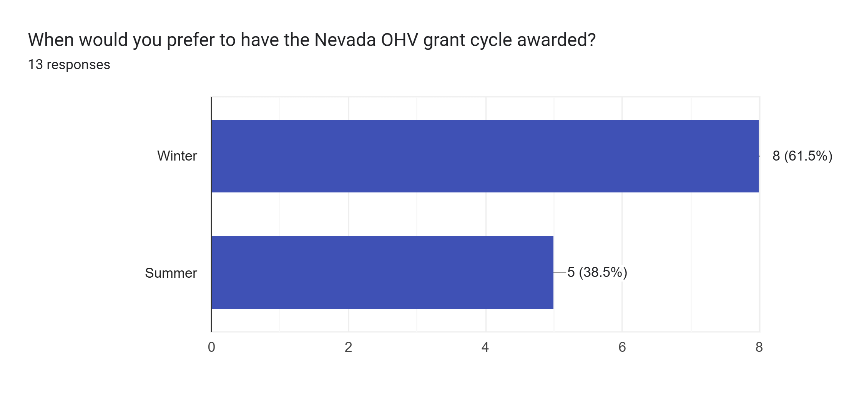
Number of Responses

Slide 27
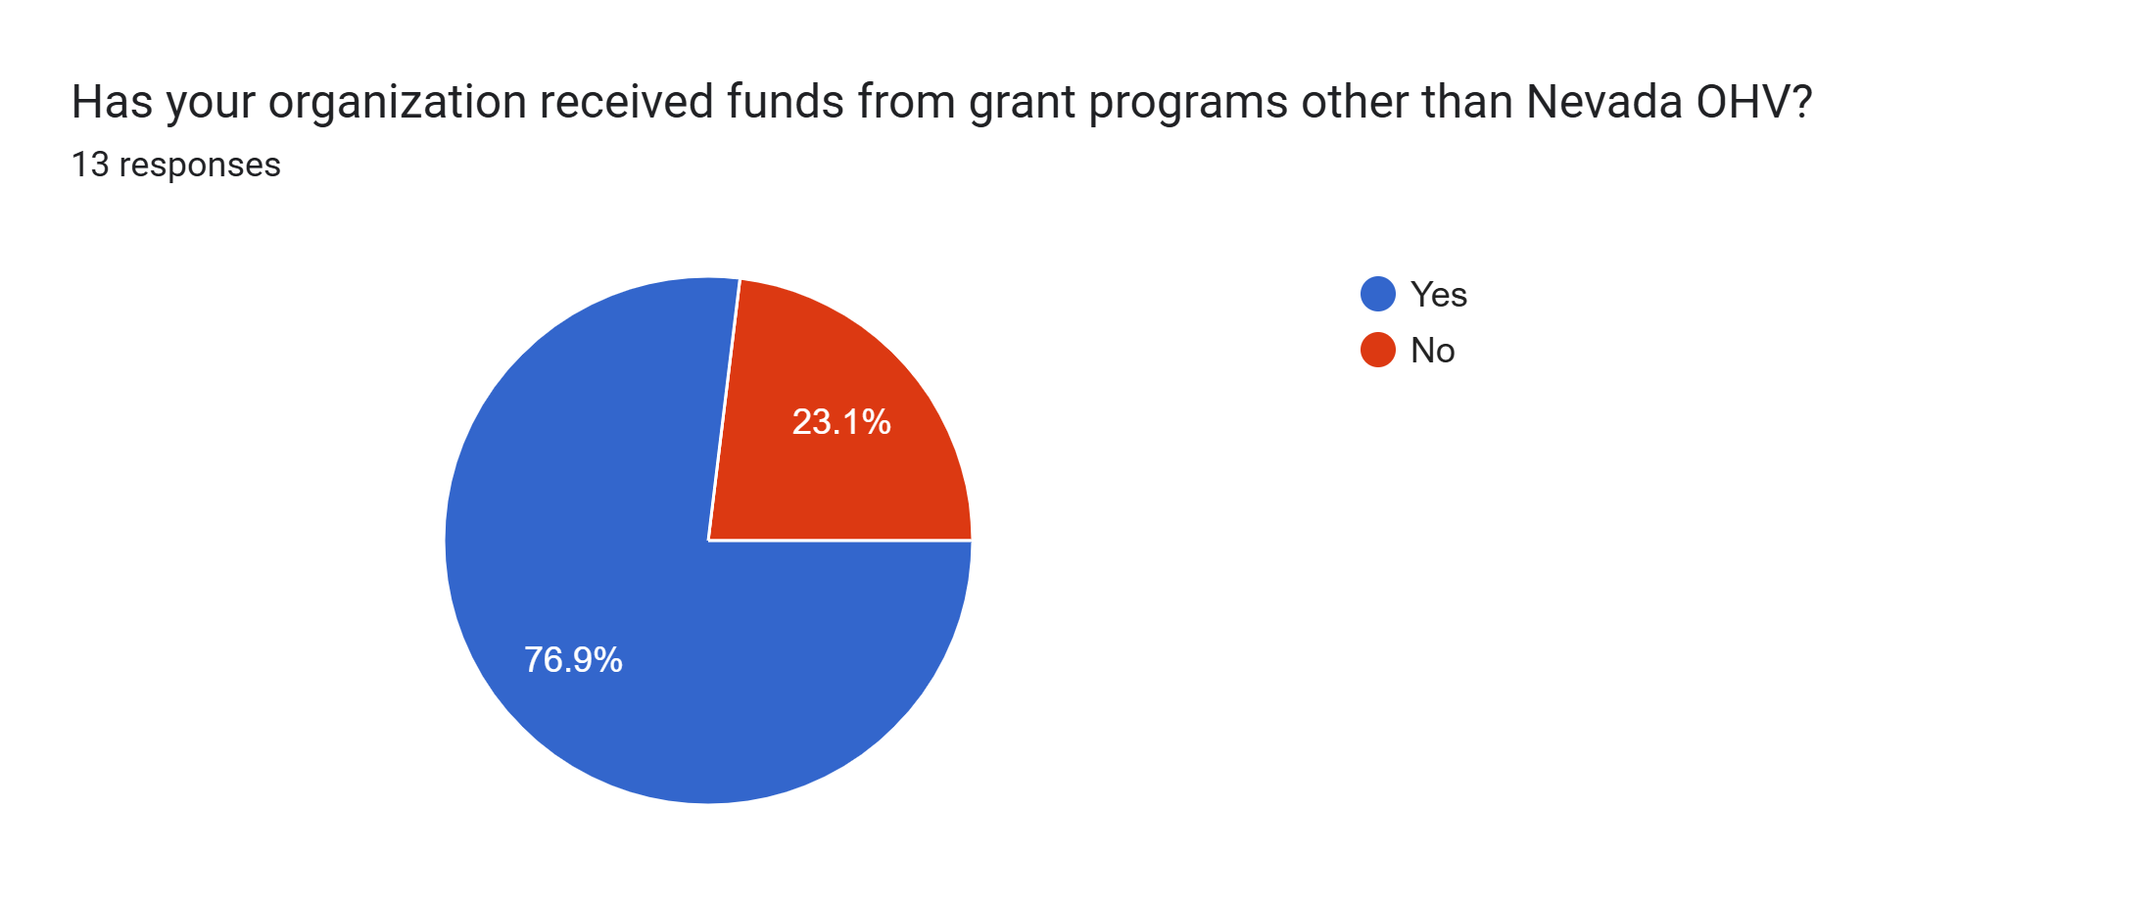

Slide 28
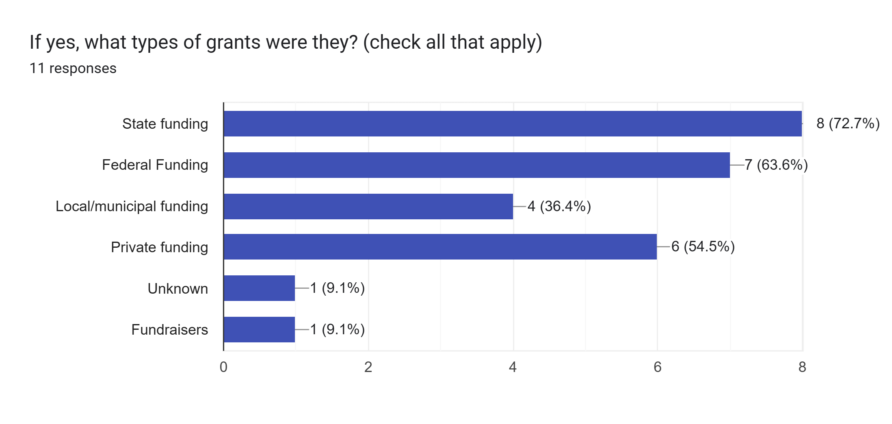
Number of Responses

Slide 29
What should the OHV Program incorporate from other funding sources? (7 Responses)
Grant Management Software
“…Other funding entities are generous and interested in granting funds. The OHV Program seems to be interested in denying applicants”
“One grant cycle per year, awarded in the winter”

Slide 30
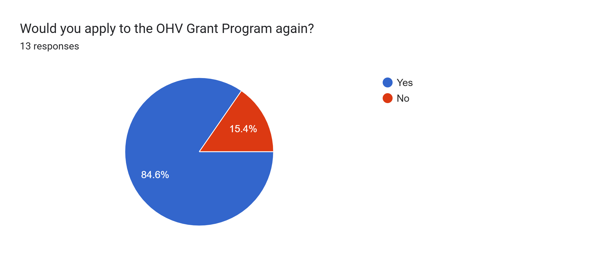

Slide 31
Would you apply to the OHV Program Again? (7 Responses)
Yes
No
Great resource for law enforcement
Funds great projects throughout the state
Can be used as match for federal funding sources
Promotes singletrack projects and provides opportunities for recreation throughout the state
“This experience has been so abhorrent, hateful, and sour, I have no interest in participating ever again”

Slide 32
Additional Feedback
“The OHV Grant Program has the potential to be a tremendous asset for our public lands and the communities that enjoy them. Unfortunately, the current approach—marked by a clear resistance toward applicants and an apparent intent to withhold funding—not only undermines those seeking to improve access and stewardship, but also jeopardizes the future of the entire program”
“When we could not complete the grant due to unforeseen circumstances, you were very gracious in letting us work out a solution without penalty”

