Slide 1


Nevada Off-Highway Vehicles Program Update
Nikhil Narkhede
7.9.2019

Slide 2
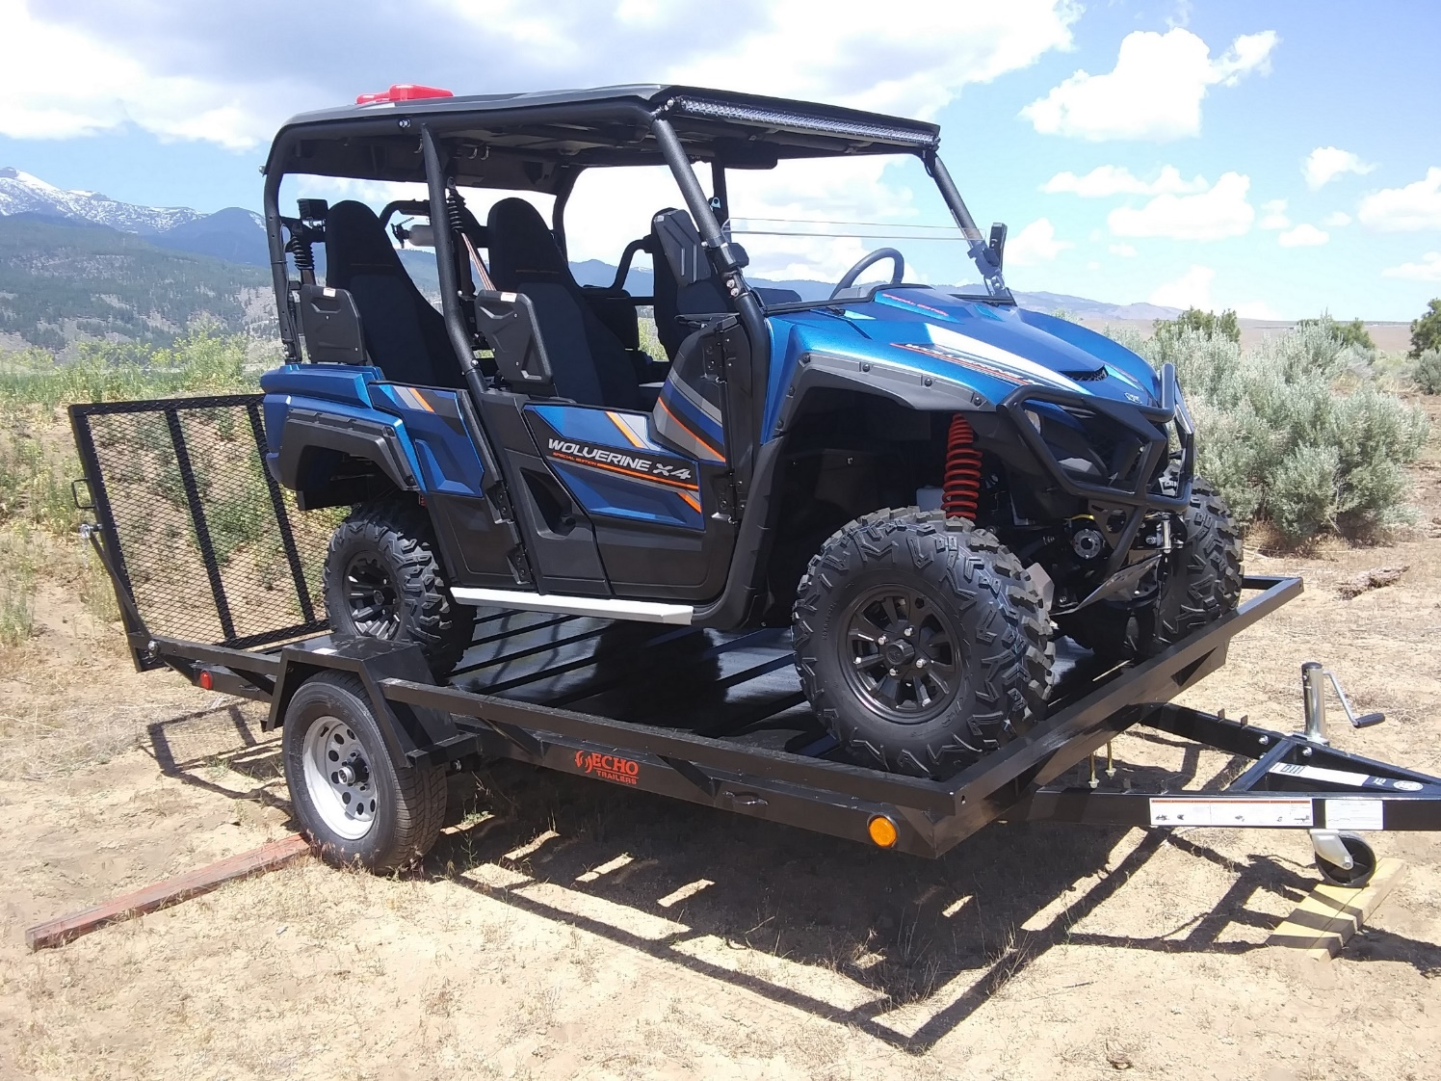
Contents
Website Changes
OHV Ambassadors
Grant Projects: LVVLT, Prison Hill, Winnemucca Sand Dunes
Land Management: White Pine County
OHV Friendly Communities
Travel Plans
Q3 Goals

Slide 3
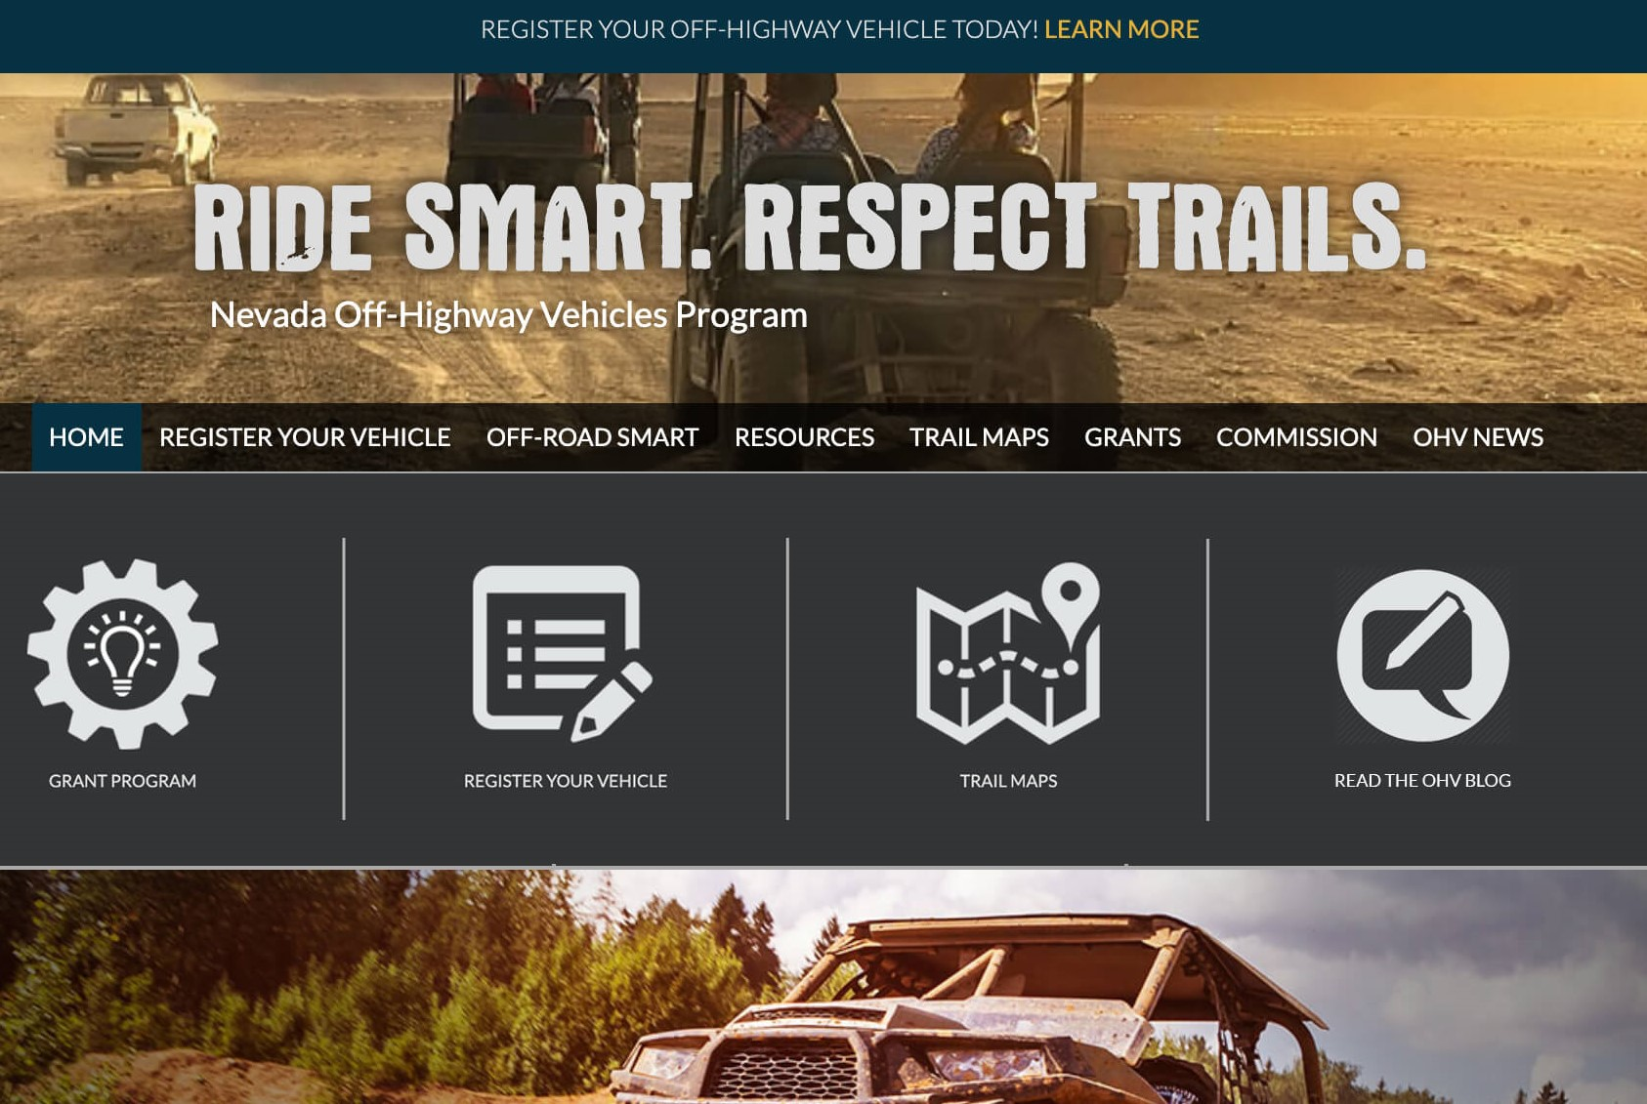
Website Changes – OHV Program Updates
WWW.OHV.NV.GOV/Blog
Content:
  OHV Friendly communities and an example of their Ordinance
  OHV trail maps training
  November Summit information
  Grant Project success stories

Slide 4
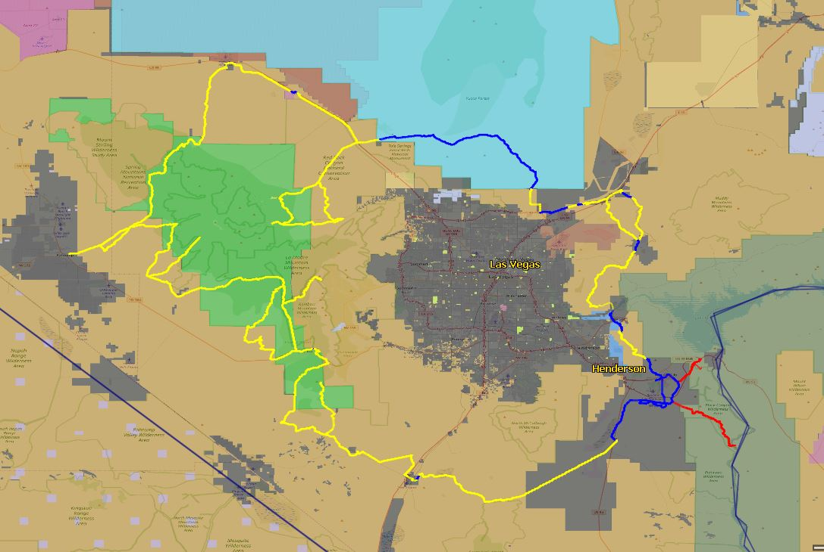
Grant Projects: LVVLT
Successes:
BLM & USFS are on board with the project!
  NEPA is the same between agencies
  Proposed route has been identified along with alternate routes and spur trails
Stakeholder meetings are in progress
  July 31, 2019 – BLM, NPS, Boulder City
Coordination with Polaris Ride Command
Challenges:
Navigating State Lands under prison and military uses
Connecting through BOR and NPS lands on the Southeast side of the loop
Boulder City OHV Ordinance did not pass

Slide 5

Grant Projects: Prison Hill
Existing trails Inventory complete
Brochure to inform public is in final stages
  Safe riding practice
  Project overview
  Partnerships involved
NOHVCC contractor is on site to identify new trail plans
Carson City to install temporary “Project in Progress” signage

Slide 6
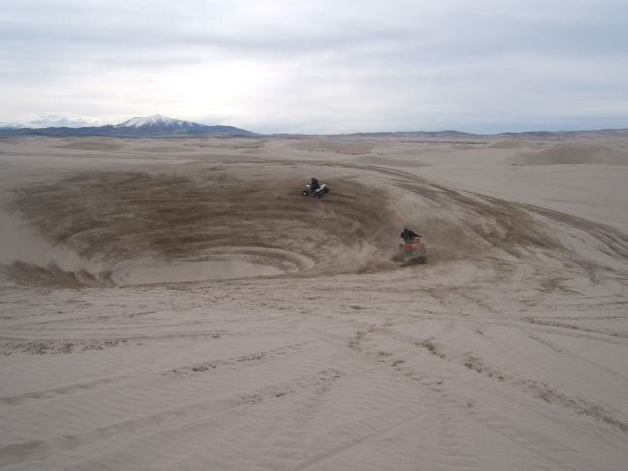
Grant Projects: Winnemucca Sand Dunes
Success:
  Equipment ordered – Storage at BLM Yard in Winnemucca
  MOU in progress between NNATV & BLM
Challenge:
  NEPA open public meetings are postponed until October
  Not posted to EPlanning
http://www.duneguide.com/sand_dune_guide_winnemucca_dunes.htm

Slide 7
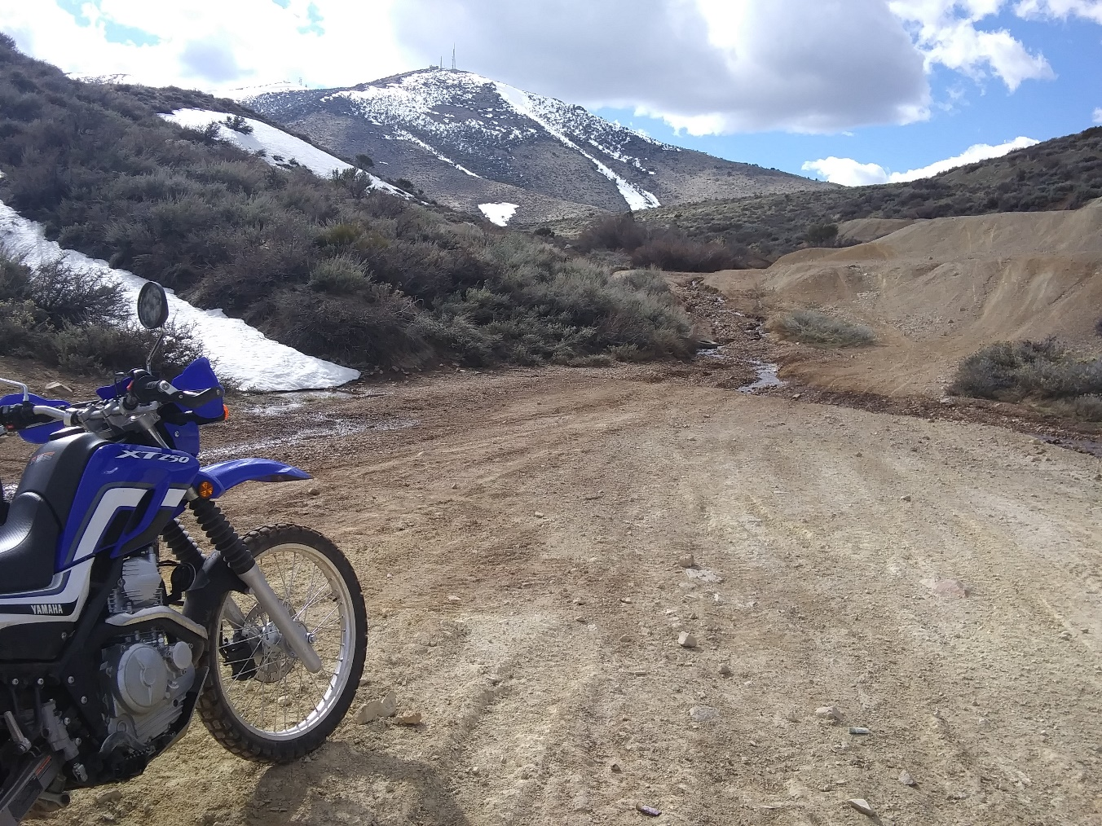
Land Management
Meetings with BLM State Director: Jon Raby
  Set quarterly meetings with BLM Leadership teams
  Receptive to maintaining OHV access
  Need to assist BLM with planning documents
  Travel Management Planning required from all districts
United State Forest Service:
  Maintenance needs are identified
  Focus on Trails vs. Roads
  INOHVCC Great Trails Handbook
White Pine County: Silver State Trail
  Closed public comment period
  Consultation with Wildlife interests
  Trailhead Developments

Slide 8
NRS 490.100
Authority of city or county to designate portion of highway for off-highway vehicle use; approval of Department of Transportation regarding state highways; interstate highways excluded; supervision of certain minors; limitation on purpose of use.
1. Except as otherwise provided in subsection 2, a city or county may designate any portion of a highway within the city or county as permissible for the operation of off-highway vehicles for the purpose of allowing off-highway vehicles to reach a private or public area that is open for use by off-highway vehicles. If a city or county designates any portion of a state highway as permissible for the operation of off-highway vehicles pursuant to this subsection, the city or county must obtain approval for the designation from the Department of Transportation. The Department of Transportation shall issue a timely decision concerning the request for approval and must not unreasonably deny the request.
2. The highway designated for operation of off-highway vehicles pursuant to subsection 1 may not consist of any portion of an interstate highway.
3. If a city or county designates a highway for the operation of off-highway vehicles, the city or county may adopt an ordinance requiring a person who is less than 16 years of age and who is operating the off-highway vehicle on a designated highway to be under the direct visual supervision of a person who is at least 18 years of age.
4. A person operating an off-highway vehicle on a highway designated for operation of off-highway vehicles pursuant to subsection 1 may not operate the off-highway vehicle on the highway for any purpose other than to travel to or from the private or public area as described in subsection 1.
(Added to NRS by 2005, 2027; A 2009, 3103; 2011, 293)

Slide 9
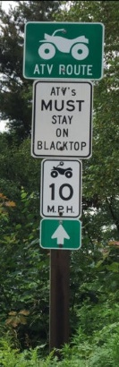
OHV Friendly Communities
City of Ely – 2019-04 – Sign installation in progress
  High Desert Trail Blazers – Dispersing OHV Friendly street maps to visitors over 7/4 weekend.
  ORD 718 – Amends Title 6 Ch 12 Sec. 2
    See supporting docs
City of Elko – 2019-03 – Ordinance change to occur in third week of July
  Not an active grant
  Notice to proceed will be provided pending approval of Ordinance.
Boulder City – Vote to pass OHV designated streets failed
Overton community streets are all within 2 miles of a trailhead, with limited connectivity

Slide 11
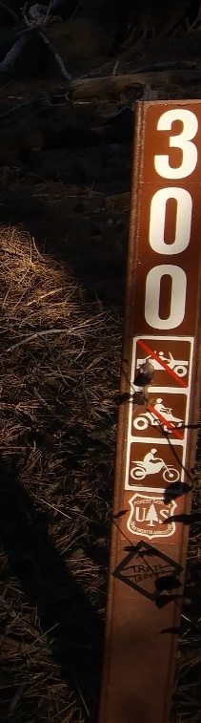
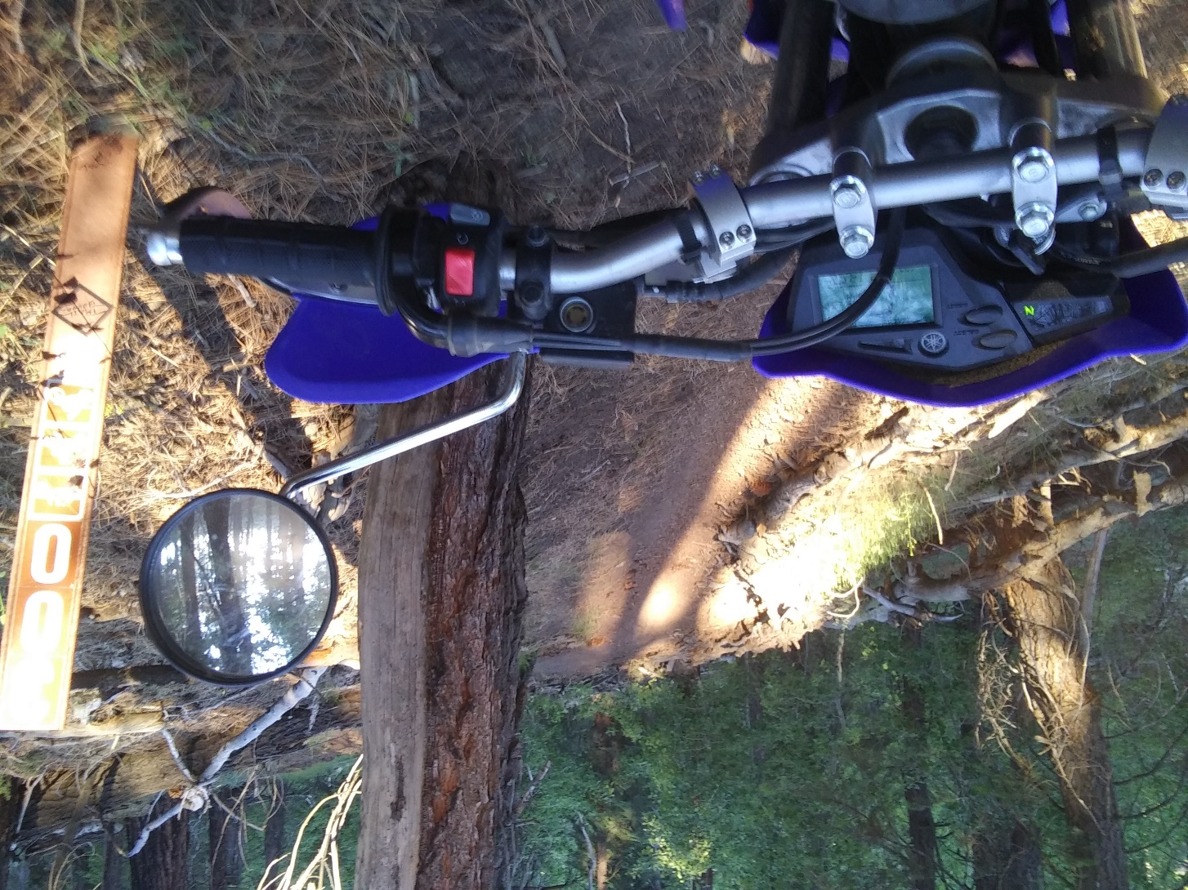
Travel Plans
Beatty – Tonopah Group Ride
  July 29 – 31
  Community & Stakeholder engagement
  Focus on Esmeralda & Nye Counties
Inyo & Bridgeport NF – Ongoing OHV Maintenance work
  Districts share forest management with CA
LVVLT – 7/31 timeframe
Local - Meetings with FONV, BLM, USFS, GBI
  Hunter lake signage, North Peavine roads maintenance

Slide 12
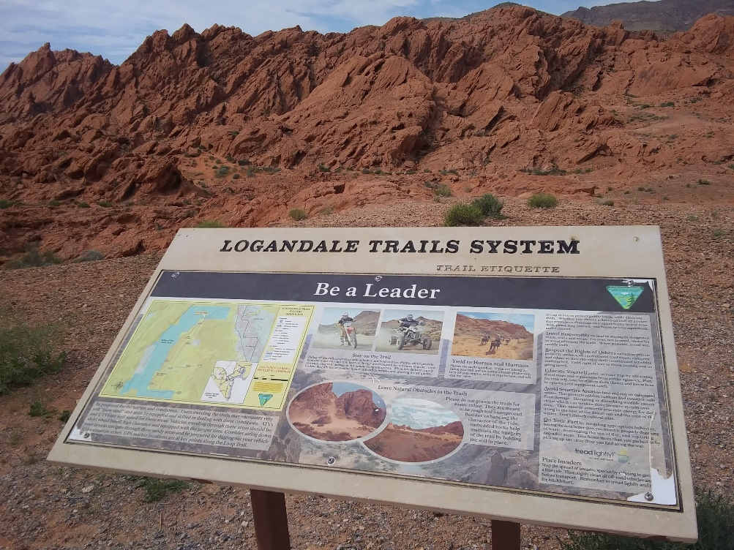
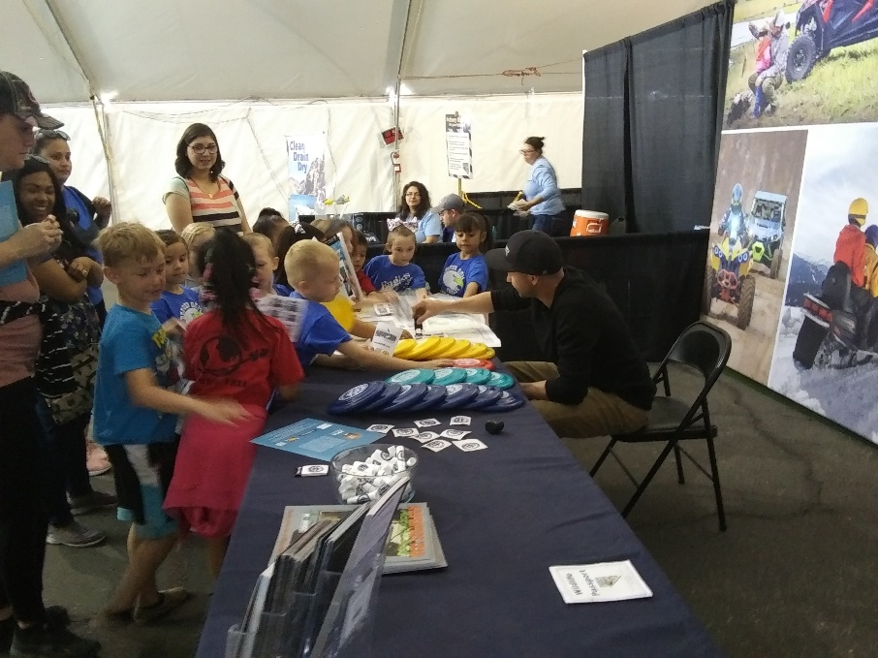
Q3 Goals & Objectives
Beatty to Tonopah – Group Ride and Grants Training
Increase Competitive Grant Applications
Maintain current grants administration workload
  Reimbursements
  Quarterlies / audits
  Proactive Communication
Increased attendance at community events
  NOS, GBI

Slide 13
Questions?

